Slide 1

The Revised 2014 ACA Code of Ethics
A Review of Critical Changes
www.counseling.org/kaplan

Slide 2
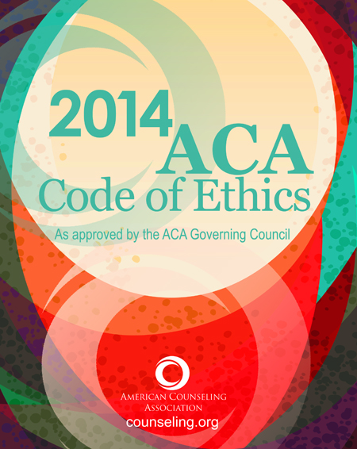
www.counseling.org/ethics

Slide 3
Perry Francis
Chair, Ethics Revision Task Force pfrancis@emich.edu
Erin Martz
Ethics Revision Task Force staff liaison emartz@counseling.org
David Kaplan
Ethics Revision Task Force staff liaison dkaplan@counseling.org

Slide 4

Why us?

Slide 5
Members of the
ACA Ethics Revision Task Force
  Jeannette Baca
  Janelle Disney
  Perry Francis (Chair)
  Gary Goodnough
  Mary Hermann
  Shannon Hodges
  Lynn Linde
Linda Shaw
Shawn Spurgeon
  Michelle Wade
  Richard Watts
  Erin Martz (staff liaison)
  David Kaplan (staff liaison)

Slide 6
Topics for today
Our personal and professional values
Raising the bar for counselor educators
Social media, distance counseling, and technology

Slide 7
Referrals, Skills, Competence, & Values
The issue of REFERRALS has been revised in the 2014 CoE
Why was this necessary
  Confusion over what constitutes basic skills
  Confusion over competence to provide services
  Confusion over imposition of values
  Confusion over issues of counter-transference

Slide 8
  What Constitutes Basic Skills?
Working with a diverse population is considered both a basic value of the profession of counseling and part of the expected basic competence.

Slide 9
From the Preamble:
  Professional values are an important way of living out an ethical commitment. The following are core professional values of the counseling profession:
    1. enhancing human development throughout the life span;
    2. honoring diversity and embracing a multicultural approach in support of the worth, dignity, potential, and uniqueness of people within their social and cultural contexts

Slide 10
What Constitutes Basic Skills?
C.2.a. BOUNDARIES OF COMPETENCE: Counselors practice only within the boundaries of their competence, based on their education, training, supervised experience, state and national professional credentials, and appropriate professional experience. Whereas multicultural counseling competency is required across all counseling specialties, counselors gain knowledge, personal awareness, sensitivity, dispositions, and skills pertinent to being a culturally competent counselor in working with a diverse client population.
What does this mean?

Slide 11
Where Does This Lead Us?
C.5. NONDISCRIMINATION: Counselors do not condone or engage in discrimination against prospective or current clients, students, employees, supervisees, or research participants based on age, culture, disability, ethnicity, race, religion/ spirituality, gender, gender identity, sexual orientation, marital/partnership status, language preference, socioeconomic status, immigration status, or any basis proscribed by law.

Slide 12
  Confusion Over Competence To Provide Services
C.2.a. BOUNDARIES OF COMPETENCE: Counselors practice only within the boundaries of their competence, based on their education, training, supervised experience, state and national professional credentials, and appropriate professional experience. Whereas multicultural counseling competency is required across all counseling specialties, counselors gain knowledge, personal awareness, sensitivity, dispositions, and skills pertinent to being a culturally competent counselor in working with a diverse client population.
What does this mean?

Slide 13
What is Competence?
Competence is not an either/or concept
  Continuum of competence
    Competence is always growing and changing with the people and issues we work with.
  Growing Competence Requirements
    Staying current with literature & knowledge
    Acquiring appropriate skills (CEUs, supervision, consultation, etc.)
    Understanding when referral is necessary due to inability to gain competence required in a timely fashion
      Fisher, 2003

Slide 14
Confusion Over Imposition of Values
A.4.b. PERSONAL VALUES: Counselors are aware of—and avoid imposing—their own values, attitudes, beliefs, and behaviors. Counselors respect the diversity of clients, trainees, and research participants and seek training in areas in which they are at risk of imposing their values onto clients, especially when the counselor’s values are inconsistent with the client’s goals or are discriminatory in nature.
What does this mean?

Slide 15
Confusion Over Issues of Counter-Transference
A.4.a. AVOIDING HARM: Counselors act to avoid harming their clients, trainees, and research participants and to minimize or to remedy unavoidable or unanticipated harm.

Slide 16
Confusion Over Issues of Counter-Transference
Confusion over referring when conflict occurs
  Professional ethics require the professional to be proactive before referring
    Obtain consultation
    Obtain supervision
    Obtain education
Referral is LAST RESORT

Slide 17

Raising the bar for counselor educators

Slide 18
Counselor educators now have the ethical obligation to provide:
Current information & knowledge (F.7.b)
Instruction only within their areas of competency (F.7.b)
Direct assistance with field placements (F.7.i)
Career assistance to students (F.8.b)

Slide 19
As well as now explicitly stating the ethics of gatekeeping
“[Counselor educators] recommend dismissal from training programs…when students are unable to demonstrate they can provide competent professional services to a range of diverse clients.” (F.6.b)
“Counselor Educators may require students to address any personal concerns that have the potential to affect professional competency” (F.8.d)

Slide 20
New Section!
H. Distance Counseling, Technology and Social Media

Slide 21
Why now? Why this?
Increased use of technology in counseling practice (globalization)
Proliferation of social media platforms
Increase in technology-related complaints/violations
Evolution of distance counseling requirements at the licensure board level

Slide 22
Distance Counseling Concerns
Informed consent requirements
Ensuring confidentiality—is this possible?
Client Verification

Slide 23
Thoughts on Technology
How do I access technology? Let me count the ways…
Reasonable access for all
Evaluating effectiveness

Slide 24
Social Media Situations
To friend or not to friend? Introducing the “Personal Virtual Relationship”
What your online presence says—and doesn’t say—about you
The perils of oversharing

Slide 25

The ACA knowledge center www.counseling.org
Where to go from here

Slide 26
ACA 2014 ethics code resources
Webinar series
Interview series
Books
  Ethics casebook by Herlihy & Corey
  Boundary Issues in Counseling by H&C
The code itself

Slide 27
Consults with the ACA ethics department
800-347-6647x314
ethics@counseling.org

Slide 28
The Revised 2014 ACA Code of Ethics
A Review of Critical Changes
www.counseling.org/kaplan

